Slide 1
Week 4 Numerical Simulation of Foams Presentation
By Tony Hau

Slide 2
Objective of this presentation section
To explain the mathematics involved in the research paper Dynamics and stationary configurations of heterogeneous foams

Slide 3

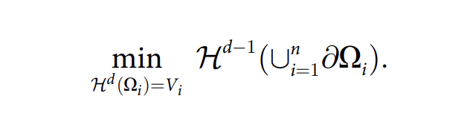




1. Principle behind bubble formation
Meaning of this equation: given a dimension d, we want to minimize its Hausdorff measure, subjected to

Slide 4
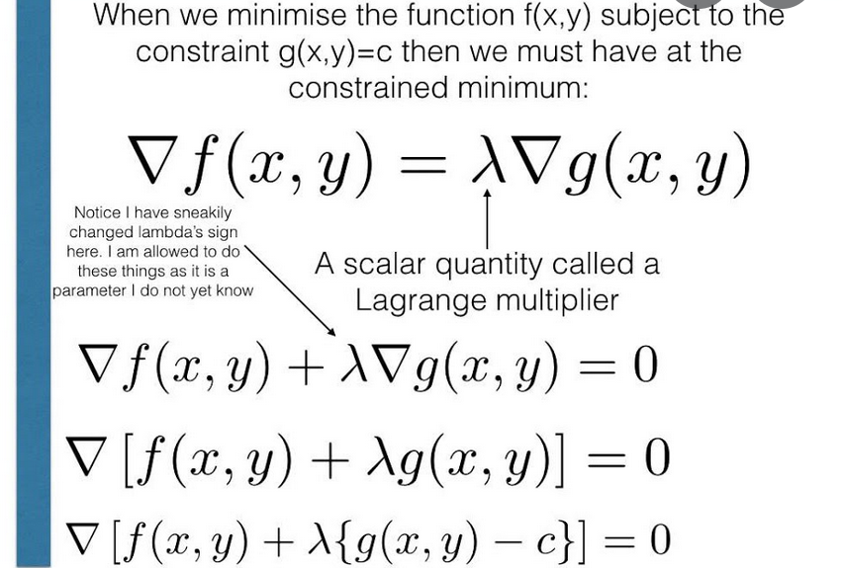

2. Lagrangian
For minimization, we introduce a Lagrangian multiplier.
We call
the Lagrangian.

Slide 5
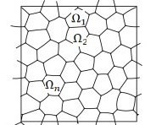
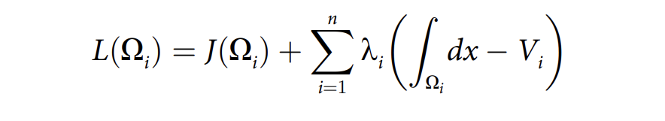
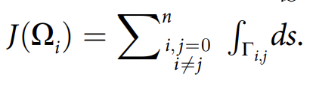

3. Two dimensional bubble minimization
Define the Lagrangian of 2d bubble as
is the total boundary length
is the area of each bubble
We minimize the total boundary length, subjected to the constrain that each bubble has a fixed area

Slide 6
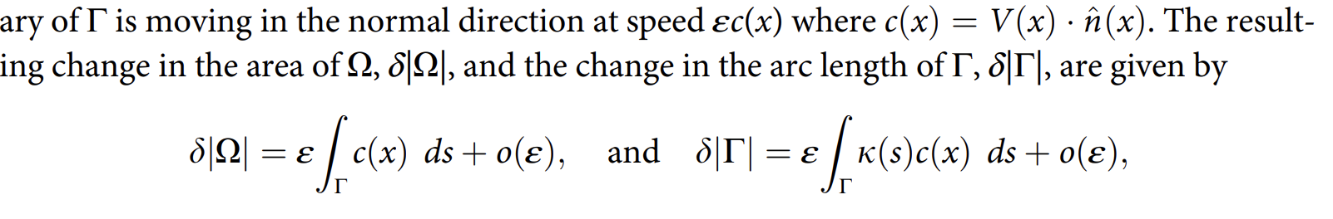
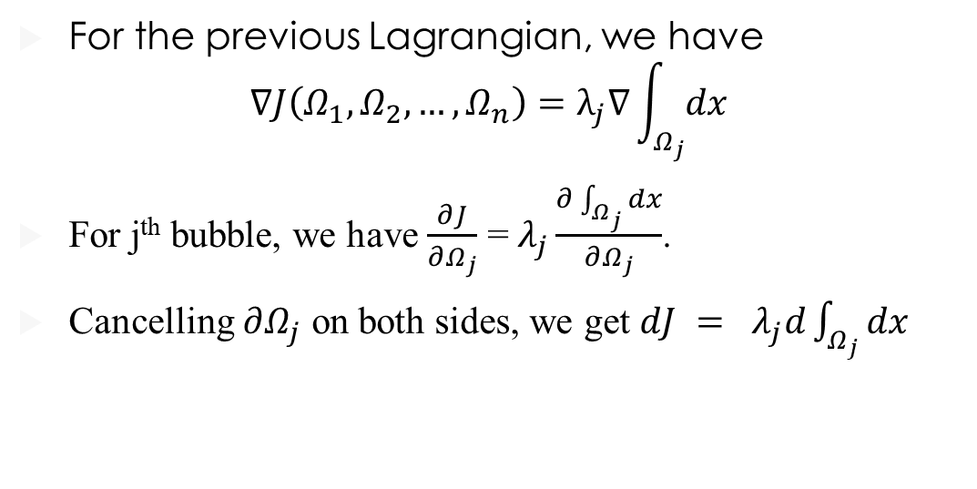
4. Proving that a minimized 2-d bubble has constant surface interface
For the previous Lagrangian, we have
$$∇J\left(Ω_{1},Ω_{2},…,Ω_{n}\right)=λ_{j}∇\int_{Ω_{j}}{dx}$$
For j^{th} bubble, we have $\frac{∂J}{∂Ω_{j}}$ = $λ_{j}\frac{∂\int_{Ω_{j}}{dx}}{∂Ω_{j}}$.
Cancelling $∂Ω_{j}$ on both sides, we get $dJ = λ_{j}d\int_{Ω_{j}}{dx}$

Slide 7
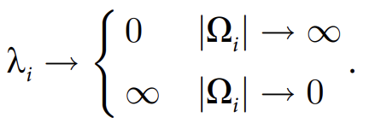

Therefore, we get $ϵ\int{k\left(s\right)c\left(s\right)ds}+o\left(ϵ\right)=λ_{j}\left(ϵ\int{c\left(x\right)ds}+o\left(ϵ\right)\right)$
After some calculations, we get
$\int{\left(λ_{j}−λ_{i}−k_{i,j}\right)cds}=0$, where $k_{i,j}$ = $k_{j}–k_{i}$.
$λ_{j}−λ_{i}=k_{i,j}$ = some constant curvature
If $λ_{j}=λ_{i}$, 0 curvature → a straight line boundary
Otherwise, curvature should bulge towards the bubble with larger area

Slide 8
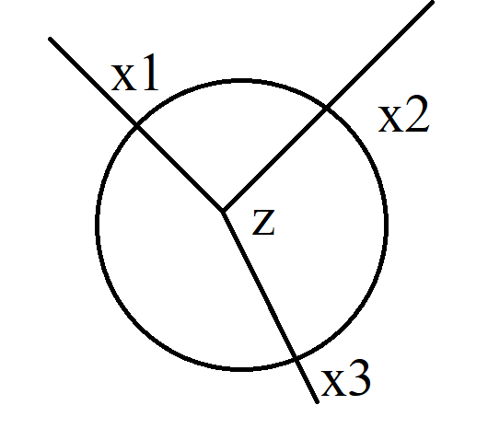
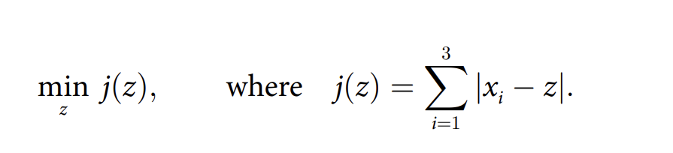
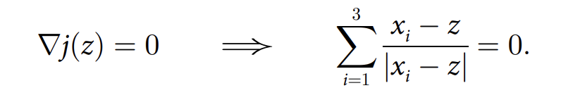
5. Proving that for a minimized 2-d bubble, triple junctions have equal angles
Diagram of a triple junction
→ meaning that the three vectors should cancel each other → angle between them is 120 degree (Pleateau’s Law)

Slide 9
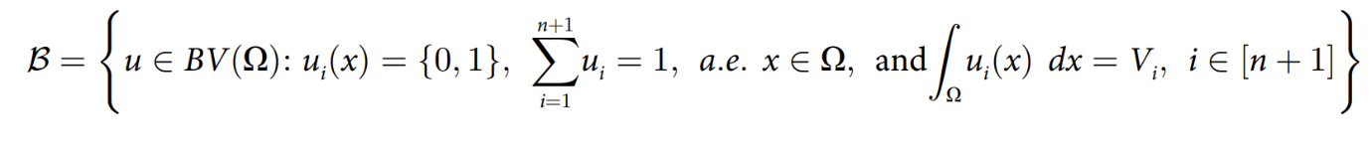
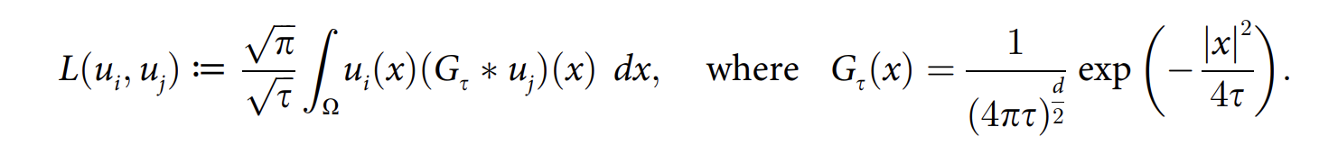
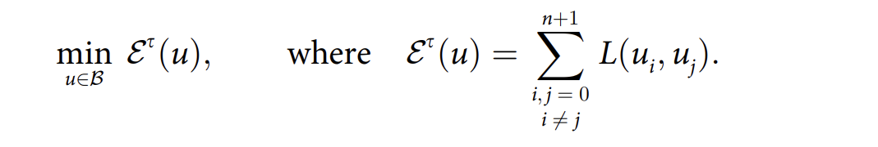
6. Computational Methods to minimize the total surface area of n 3-d bubbles given their volume constrain
Define the following function, with u as a indicator for a 3d bubble
, where we approximate the surface area of each bubble as

Slide 10
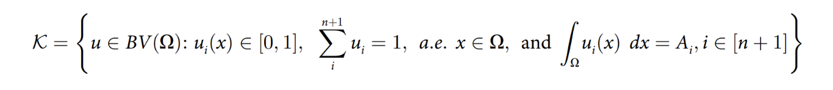
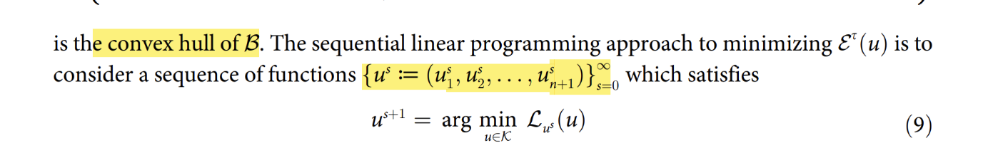
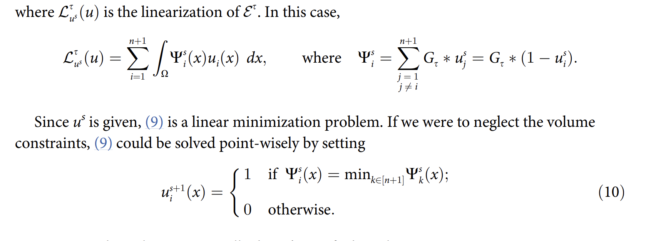
We find the convex hull of B and get K

Slide 11
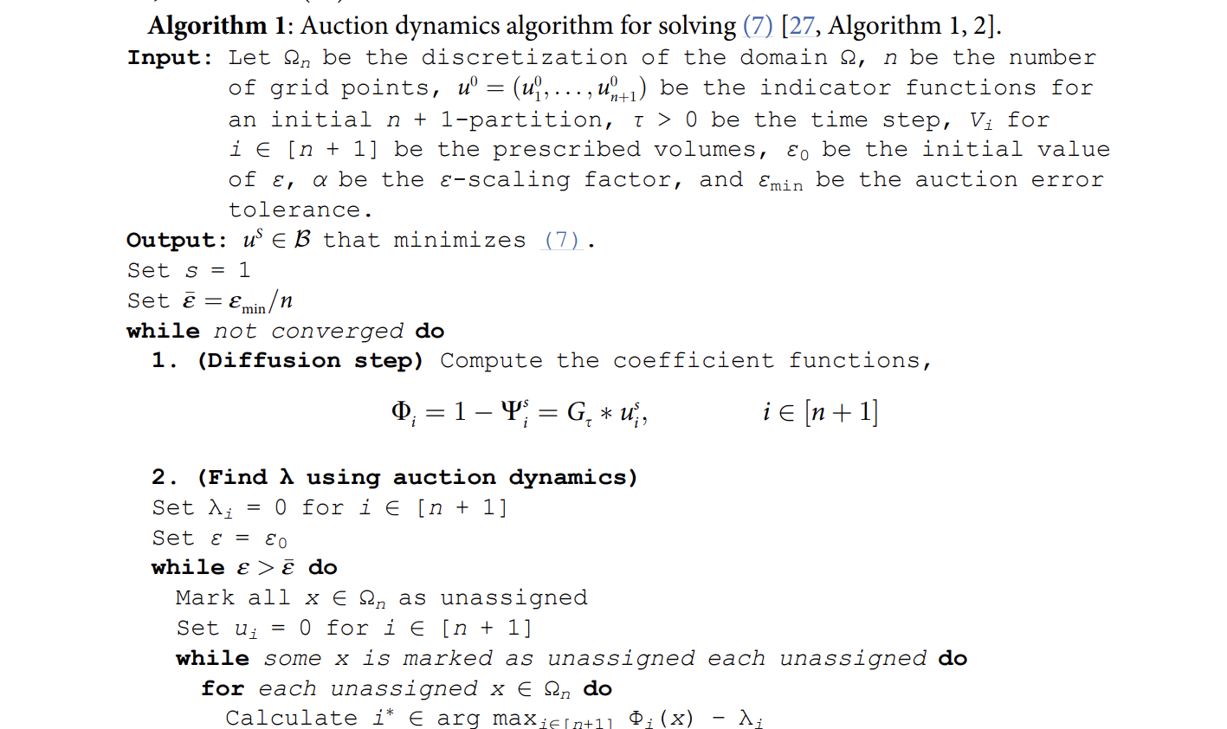
7. Algorithm to solve for indicator bubble function u
Below is the (7)

